Slide 1

Classifier Performance Evaluation
Dr. Retno Kusumaningrum, S.Si., M.Kom.

Slide 2
Classifier Experimental Evaluation
Classifiers are learned on a finite training multiset
A learned classifier has to be tested on a different test set experimentally
The classifier performs on different data in the run mode that on which it has learned
The experimental performance on the test data is a proxy for the performance on unseen data. It checks the classifier’s generalization ability.
There is a need for a criterion function assessing the classifier performance experimentally.
A need for comparing classifiers experimentally

Slide 3
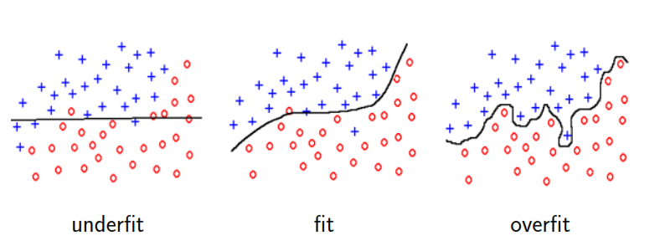
Danger of Overfitting
Learning the training data too precisely usually leads to poor classification results on new data
Classifier has to have the ability to generalize

Slide 4
Training vs Testing Data
Problem : Finite data are available only and have to be used both for training and testing
More training data gives better generalization
More testing data gives better estimate for the classification error probability
Never evaluate performance on training data
The Conclusion would be optimistically biased

Slide 5
Training vs Testing Data
Partitioning of available finite set of data to training / test sets
Hold out
Cross Validation
Bootstrap
Once evaluation is finished, all the available data can be used to train the final classifier

Slide 6

Hold out method
Given data is randomly partitioned into two independent sets
Training multi-set (e.g. 2/3 of data) for the statistical model construction, i.e. Learning the classifier
Test set (e.g. 1/3 of data) is hold out for the accuracy estimation of the classifier
Random sampling is a variation of the hold out method:
Repeat the hold out $k$ times, the accuracy is estimated as the average of the accuracies obtained

Slide 7

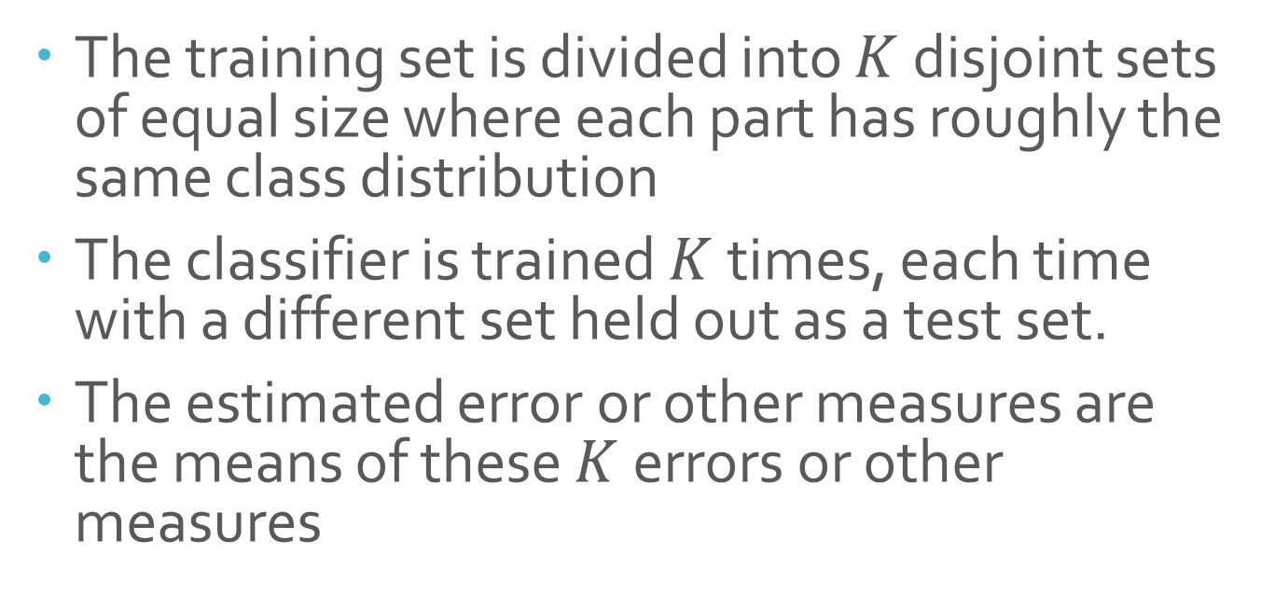
$K$-fold cross validation
The training set is divided into $K$ disjoint sets of equal size where each part has roughly the same class distribution
The classifier is trained $K$times, each time with a different set held out as a test set.
The estimated error or other measures are the means of these $K$ errors or other measures

Slide 8
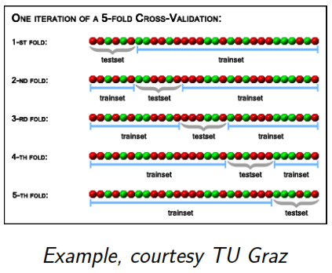

Slide 9

Leave-one-out
A spesial case of $K$-fold cross validation with $K=n$, where $n$ is the total number of samples in the training multiset
$n$experiments are performed using $n −1$ samples for training and the remaining samples for testing.
It is rather computationally expensive
Leave-one-out cross-validation does not guarantee the same class distribution in training and test data

Slide 10

Bootstrap aggregating, called also bagging
The bootstrap uses sampling with replacement to form the training set
Given: the training set $T$ consisting of $n$ entries
Bootstrap generates $m$ new datasets $T_{i}$ each of size $n^{′}≪n$ by sampling $T$ uniformly with replacement. The consequence is that some entries can be repeated in $T_{i}$.
In special case (called 632 boosting) when $n^{′}=n$ for large $n$, $T_{i}$ is expected to have $1−\frac{1}{e}≈63,2\%$ of unique samples. The rest are duplicates
The $m$ models are learned using the above $m$ bootstrap samples
The statistical models are combined, e.g. by averaging the output (for regression) or by voting (for classification)

Slide 11
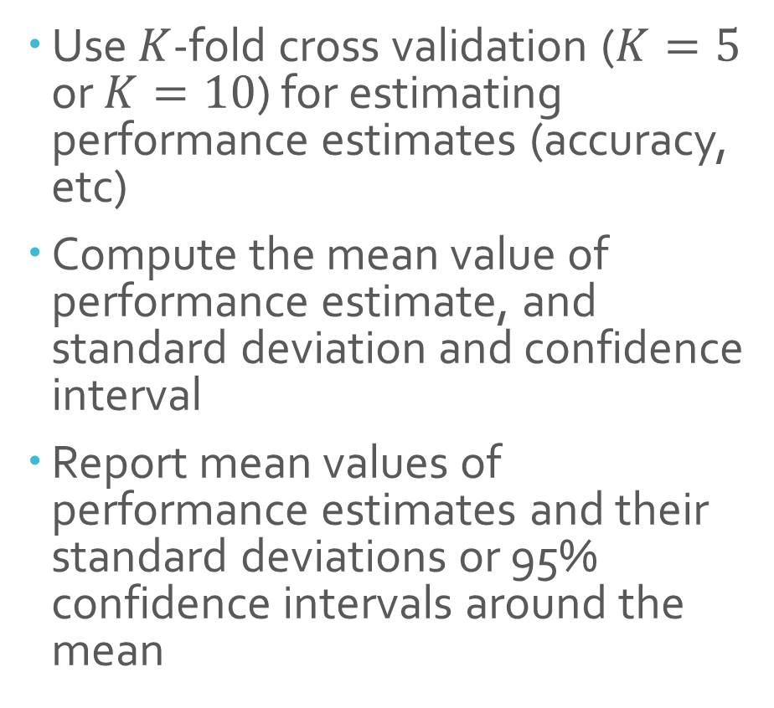
Recomended Experimental Validation Procedure
Use $K$-fold cross validation ($K=5$ or $K=10$) for estimating performance estimates (accuracy, etc)
Compute the mean value of performance estimate, and standard deviation and confidence interval
Report mean values of performance estimates and their standard deviations or 95% confidence intervals around the mean

Slide 12
Accuracy Measure - 1
Sebagian besar ukuran akurasi diturunkan dari classification matrix (disebut juga sebagai confusion matrix)
Matriks tersebut meringkas data correct/incorrect classification yang dihasilkan oleh sebuah metode/model klasifikasi untuk suatu dataset.
Baris dan kolom dari confusion matrix terkait dengan informasi true classes (gold standard / kelas yang sebenarnya) serta predicted classes (kelas yang diprediksi).

Slide 13

Contoh - $2×2$ Confusion Matrix
 |  | Predicted Class
 |  | C1 | C2
Actual Class | C1 | 231 | 19
 | C2 | 38 | 212
Confusion matrix untuk permasalahan klasifikasi dua kelas (C1/C2) dengan jumlah data 500 yang terbagi menjadi 250 data per kelas.
Diagonal cell menunjukkan jumlah data yang terklasifikasi dengan benar (correct classification).
Off-diagonal cells menunjukkan jumlah data yang tidak terklasifikasi dengan benar (misclassification).
Top-right cell menunjukkan jumlah kelas C1 yang terklasifikasi salah ke dalam C2 dan sebaliknya untuk lower-left cell

Slide 14

Bentuk Umum - $2×2$ Confusion Matrix
 |  | Predicted Class
 |  | + | -
Actual Class | + | TP | FN | C = TP+FN
 | - | FP | TN | D = FP+TN
 |  | A = TP+FP | B = FN+TN | T = TP+FN+FP+TN

Slide 15
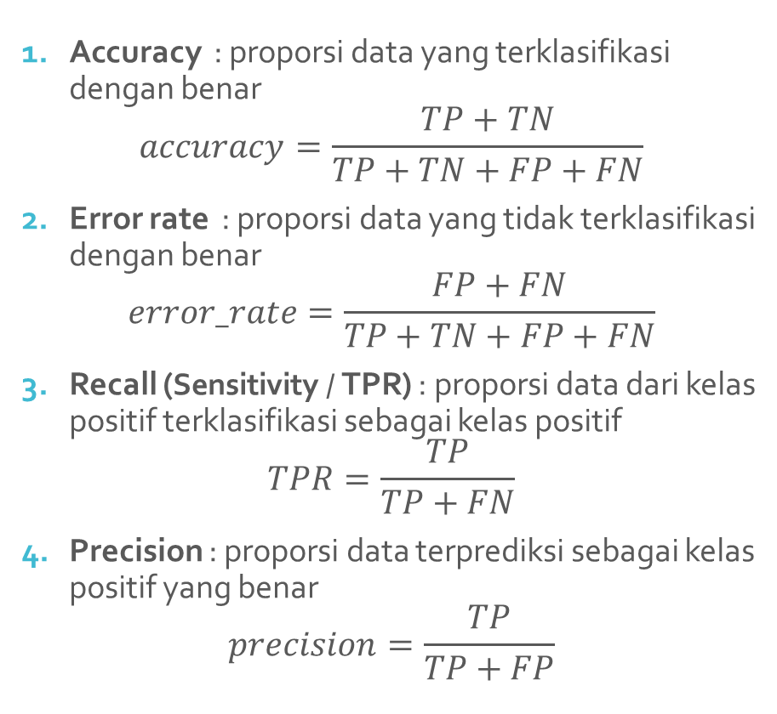
Performance Metrics
Accuracy : proporsi data yang terklasifikasi dengan benar
$$accuracy=\frac{TP+TN}{TP+TN+FP+FN}$$
Error rate : proporsi data yang tidak terklasifikasi dengan benar
$$error_rate=\frac{FP+FN}{TP+TN+FP+FN}$$
Recall (Sensitivity / TPR) : proporsi data dari kelas positif terklasifikasi sebagai kelas positif
$$TPR=\frac{TP}{TP+FN}$$
Precision : proporsi data terprediksi sebagai kelas positif yang benar
$$precision=\frac{TP}{TP+FP}$$

Slide 16
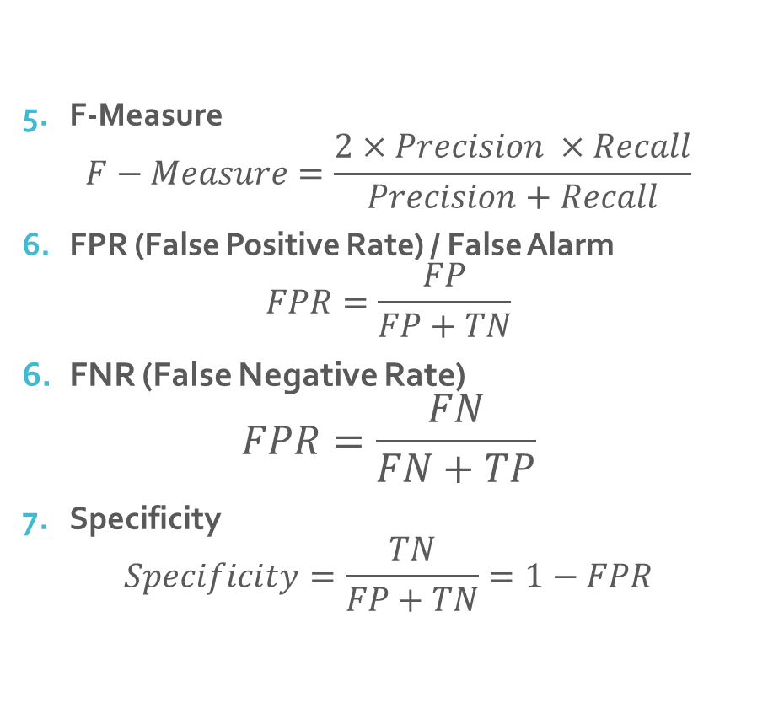
Performance Metrics (2)
F-Measure
$$F−Measure=\frac{2×Precision ×Recall}{Precision+Recall}$$
FPR (False Positive Rate) / False Alarm
$$FPR=\frac{FP}{FP+TN}$$
FNR (False Negative Rate)
$$FPR=\frac{FN}{FN+TP}$$
Specificity
$$Specificity=\frac{TN}{FP+TN}=1−FPR$$

Slide 17
Performance in Unequal Importance of Classes
Apabila terdapat dua kelas yang memiliki dua kelas yang memiliki tingkat kepentingan yang berbeda (assymetric)
Lebih penting untuk memprediksi suatu data ke dalam kelas
Kelas 1 dibandingkan Kelas 2
Kelas + daripada Kelas –
Accuracy bukan merupakan ukuran kinerja yang bagus untuk mengevaluasi sebuah pengklasifikasi
Gunakan sensitivity, specificity, FPR, FNR
Misalnya untuk memprediksi status keuangan sebuah perusahaan dikatakan akan bangkrut atau tidak
Lebih penting untuk memprediksi bahwa suatu perusahaan mengalami kebangkrutan daripada tetap diprediksi sebagai perusahaan normal
Tentukan data TP sebagai kondisi klasifikasi yang paling penting

Slide 18
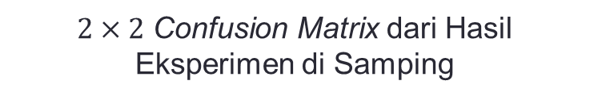
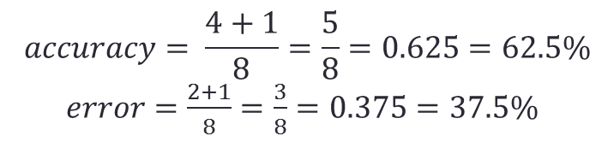
Contoh Soalcs
Hasil Eksperimen sebuah Algoritma Klasifikasi
Data Testing | Actual Class | Predicted Class
1 | C1 | C1
2 | C1 | C1
3 | C1 | C1
4 | C1 | C1
5 | C1 | C2
6 | C2 | C1
7 | C2 | C1
8 | C2 | C2
$2×2$ Confusion Matrix dari Hasil Eksperimen di Samping
 |  | Predicted Class
 |  | C1 | C2
Actual Class | C1 | 4 | 1 | C = 5
 | C2 | 2 | 1 | D = 3
 |  | A = 6 | B = 2 | T = 8
TP = 4 FP = 1 TN = 1 FN = 2
$$accuracy= \frac{4+1}{8}=\frac{5}{8}=0.625=62.5\%$$
$error=\frac{2+1}{8}=\frac{3}{8}=0.375=37.5\%$

Slide 19



Contoh Soal 2
Data hasil klasifikasi citra diabetic retinopathy menunjukkan data confusion matrix sebagai berikut:
 |  | Predicted Class
 |  | Normal | Abnormal
Actual Class | Normal | 4 | 1 | C = 5
 | Abnormal | 2 | 1 | D = 3
 |  | A = 6 | B = 2 | T = 8
True Negative
False Positive
True Positive
False Negative
$$sensitivity=\frac{TP}{TP+FN}=\frac{1}{1+2}=\frac{1}{3}=33.3\%$$
$$specificity=\frac{TN}{FP+TN}=\frac{4}{1+4}=\frac{4}{5}=80\%$$
$$FPR=\frac{FP}{FP+TN}=\frac{1}{1+4}=\frac{1}{5}=20\%$$

Slide 20
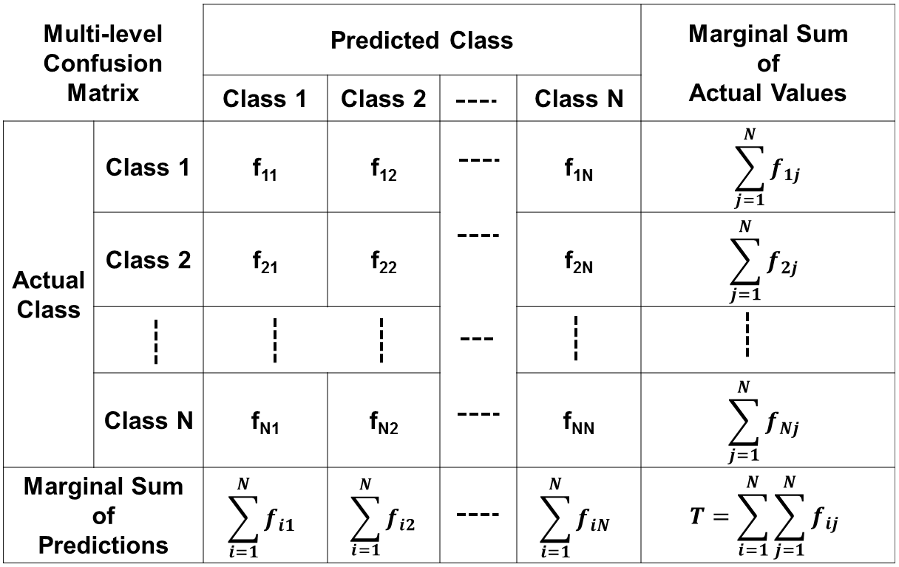
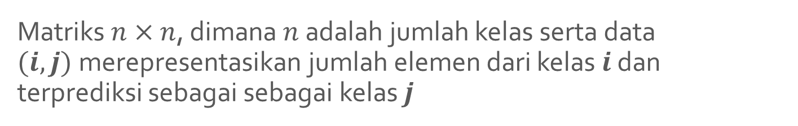
Multi-level Confusion Matrix
Matriks $n×n$, dimana $n$adalah jumlah kelas serta data $(i,j)$merepresentasikan jumlah elemen dari kelas $i$ dan terprediksi sebagai sebagai kelas $j$

Slide 21
Contoh - Multi-level Confusion Matrix
 |  | Predicted Class |  |  | Marginal Sum of Actual Values
 |  | Class 1 | Class 2 | Class 3
Actual Class | Class 1 | 2 | 1 | 1 | 4
 | Class 2 | 1 | 2 | 1 | 4
 | Class 3 | 1 | 2 | 3 | 6
Marginal Sum of Predictions |  | 4 | 5 | 5 | T = 14

Slide 22
Konversi Multi-level Confusion Matrix ke Bentuk $2×2$
f₊₊
 |  | Predicted Class
 |  | Class 1 | Class 2 | Class 3
Actual Class | Class 1 | 2 | 1 | 1
 | Class 2 | 1 | 2 | 1
 | Class 3 | 1 | 2 | 3
f₋₊
f₊₋
f₋₋
 |  | Predicted Class
 |  | Class 1 (+) | Not Class 1 (-)
Actual Class | Class 1 (+) | 2 | 2 | C = 4
 | Not Class 1 (-) | 2 | 8 | D = 10
 |  | A = 4 | B = 10 | T = 14
2X2 Matrix
Specific to Class 1
Accuracy = 2/14
Error = 8/14
Recall = 2/4
Precision = 2/4

Slide 23
Accuracy Measure - 2
Berdasarkan Receiver Operating Characteristics (ROC)
Area under the ROC curve (AUC)
Banyak digunakan pada bidang Medical Diagnosis
Dominance Relationship:
A ROC curve A dominates another ROC curve B if A is always above and to the left of B in the plot
Source :
Lozano, J. A., Santafé, G., & Inza, I. (2010). Classifier performance evaluation and comparison (pp. 48–56).

Slide 24
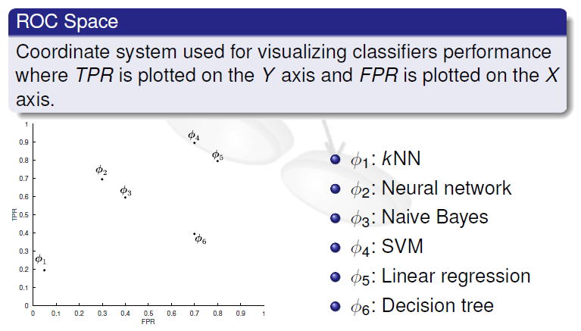
Receiver Operating Characteristics (ROC)

Slide 25
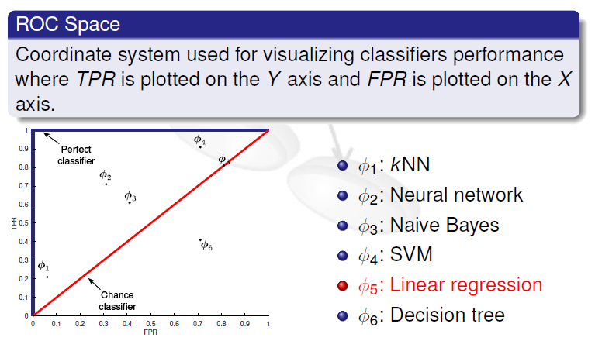
Receiver Operating Characteristics (ROC)

Slide 26
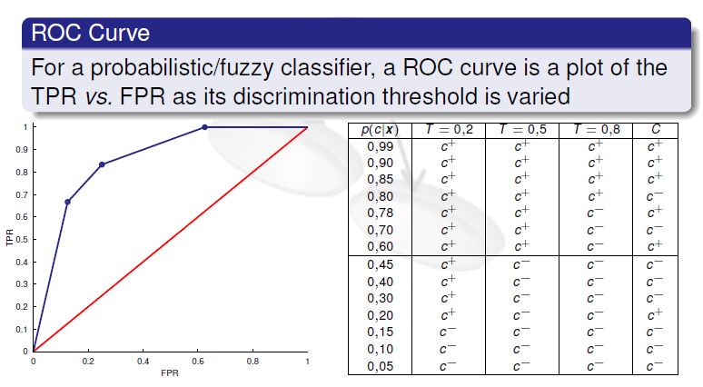
Receiver Operating Characteristics (ROC)

Slide 27
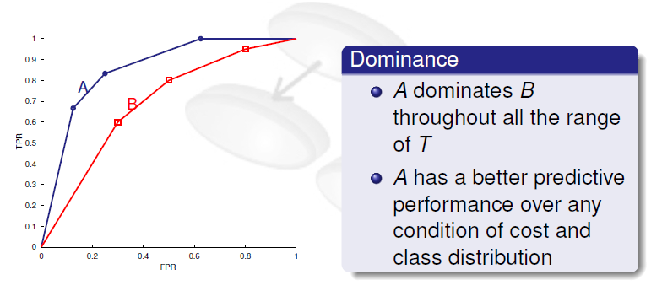
Receiver Operating Characteristics (ROC)

Slide 28
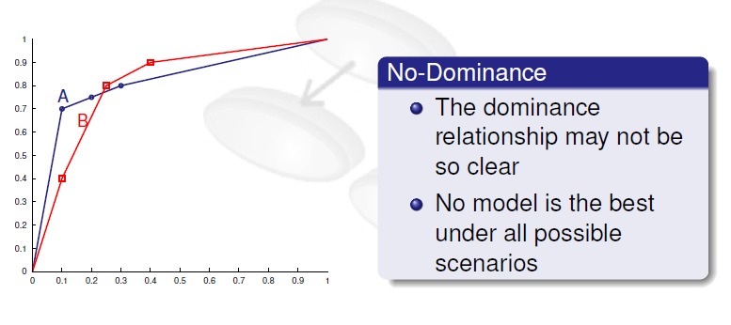
Receiver Operating Characteristics (ROC)

Slide 29
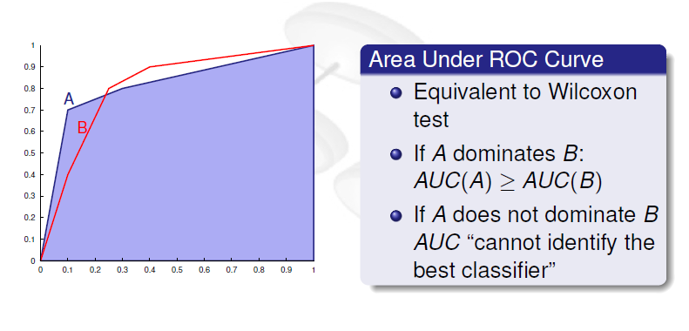
Receiver Operating Characteristics (ROC)

